Slide 1


HOTEL DATABASE MANAGEMENT SYSTEM Prepared By –
Afser Adil Olin(AE-47)
Anika Tabassum(Rk-61)

Slide 2
A Hotel consists of a wide areas to manage. We tried to include the main areas for a hotel management system in this project.
ROOMS
BOOKINGS
HOTEL
EMPLOYEES
GUESTS

Slide 3


The main objective of this project is to create a database management system for a hotel.
The main objective of a hotel management system is to automate and streamline the operations and administration of a hotel, including functions such as reservations, front desk management, room management, billing and accounting, and reporting. It is designed to improve efficiency, increase revenue, and provide a better guest experience.

Slide 4
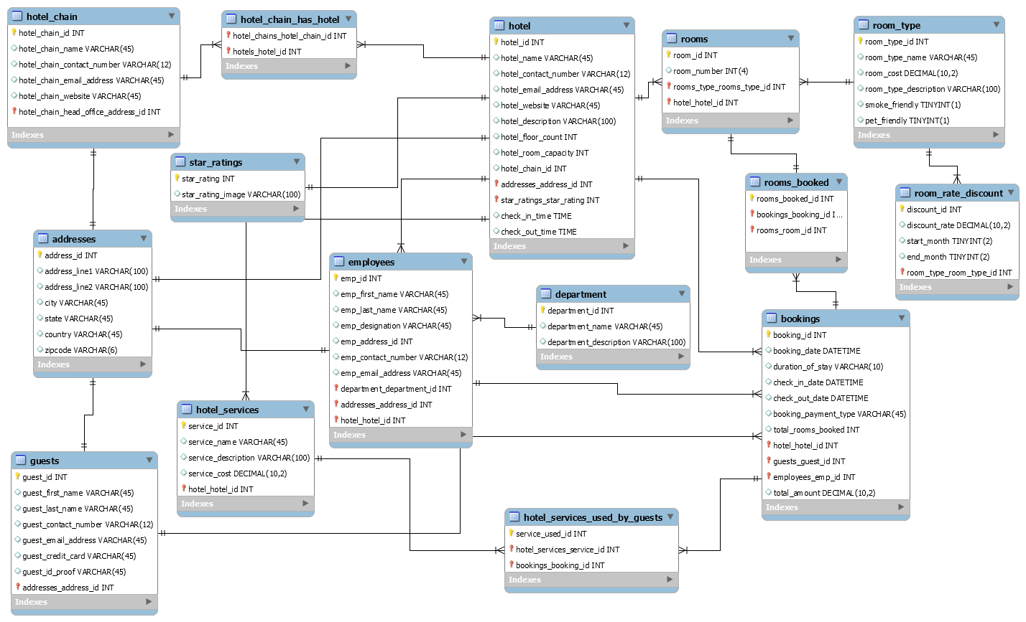
ER Diagram

Slide 5
List of Tables
Addresses
Hotel chain
Hotel
Hotel chain has hotel
Bookings
Rooms Booked
Department
Employees
Guests
Hotel services
Hotel services used by guests
Room type
Rooms
Room rate discount
Star ratings

Slide 6
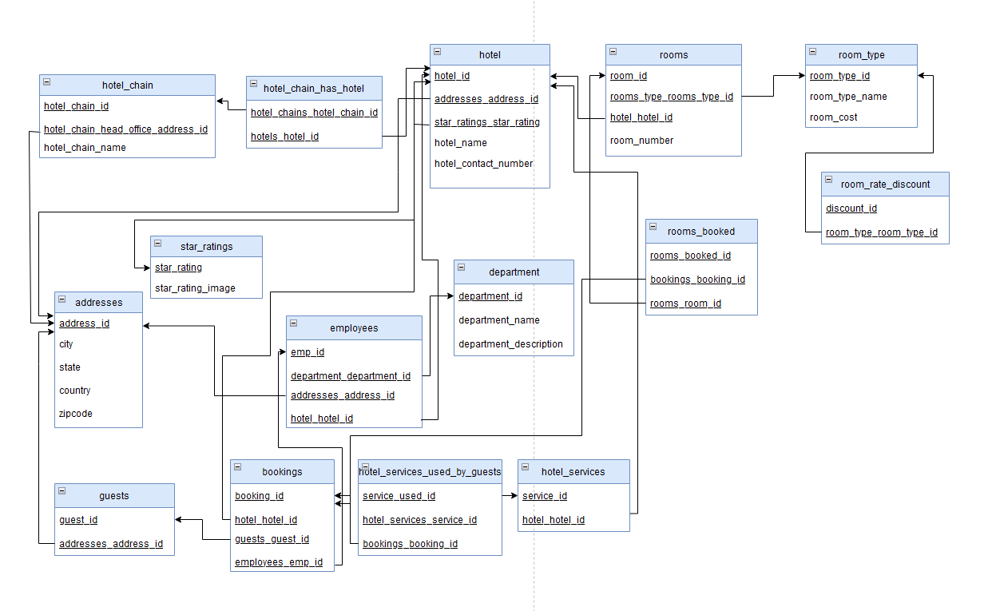
Schema Diagram

Slide 7

Let us begin exploring the TABLES

Slide 8
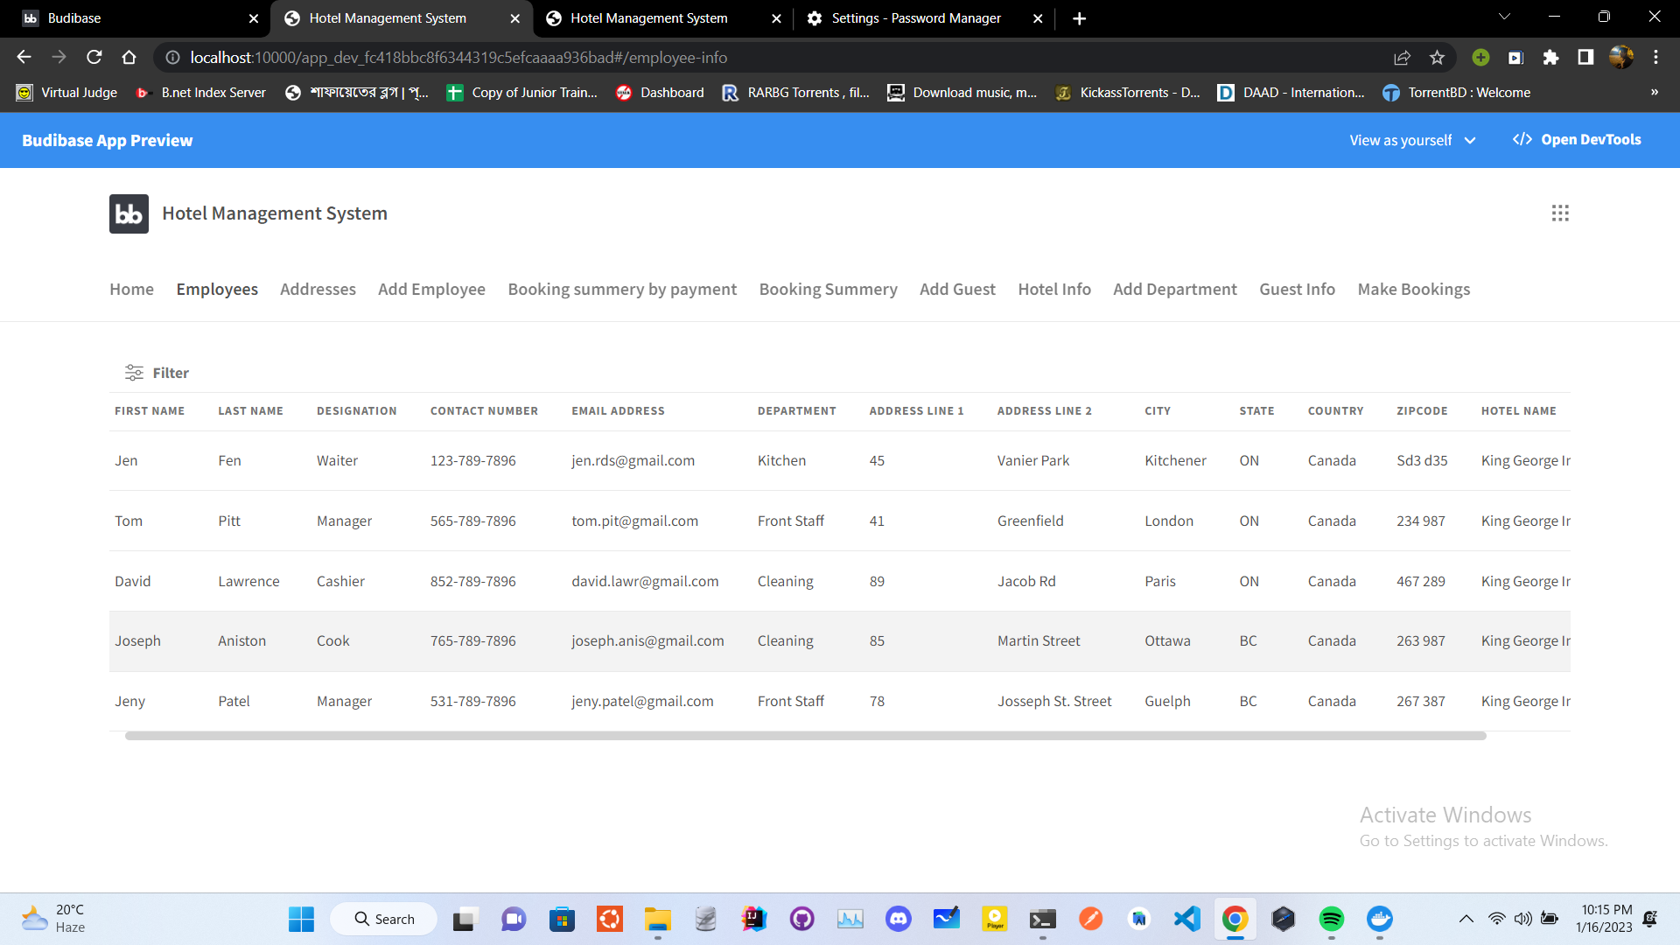
Employees Table

Slide 9
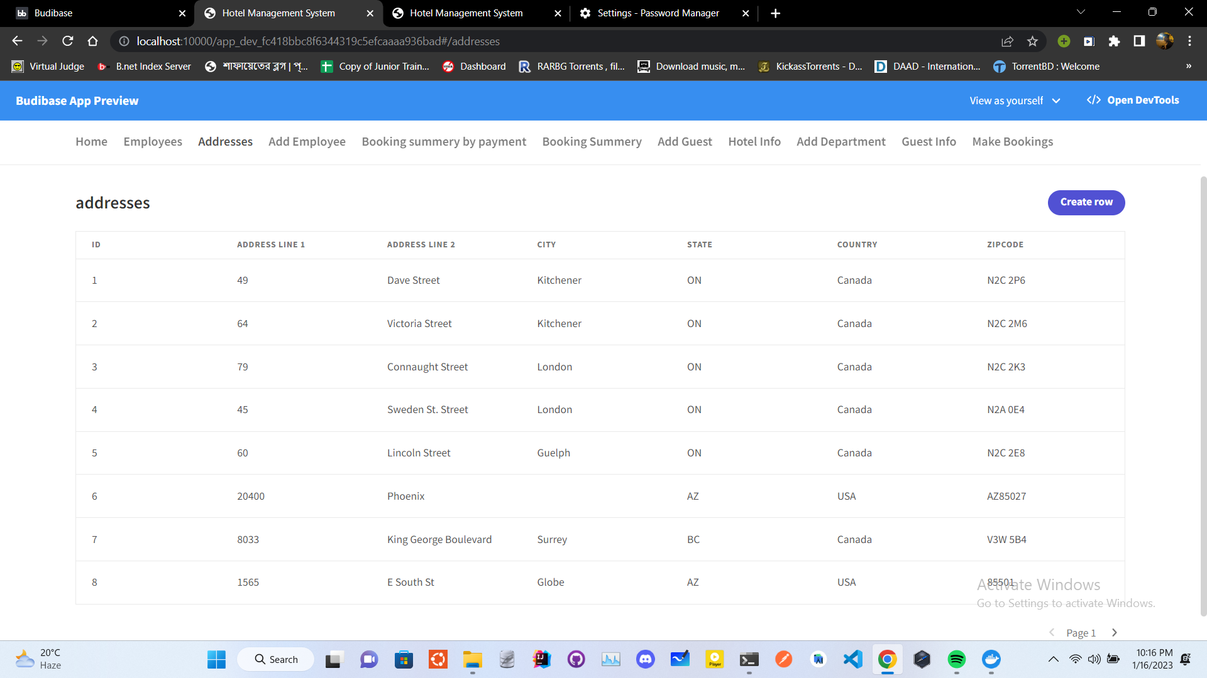
Addresses Table

Slide 10
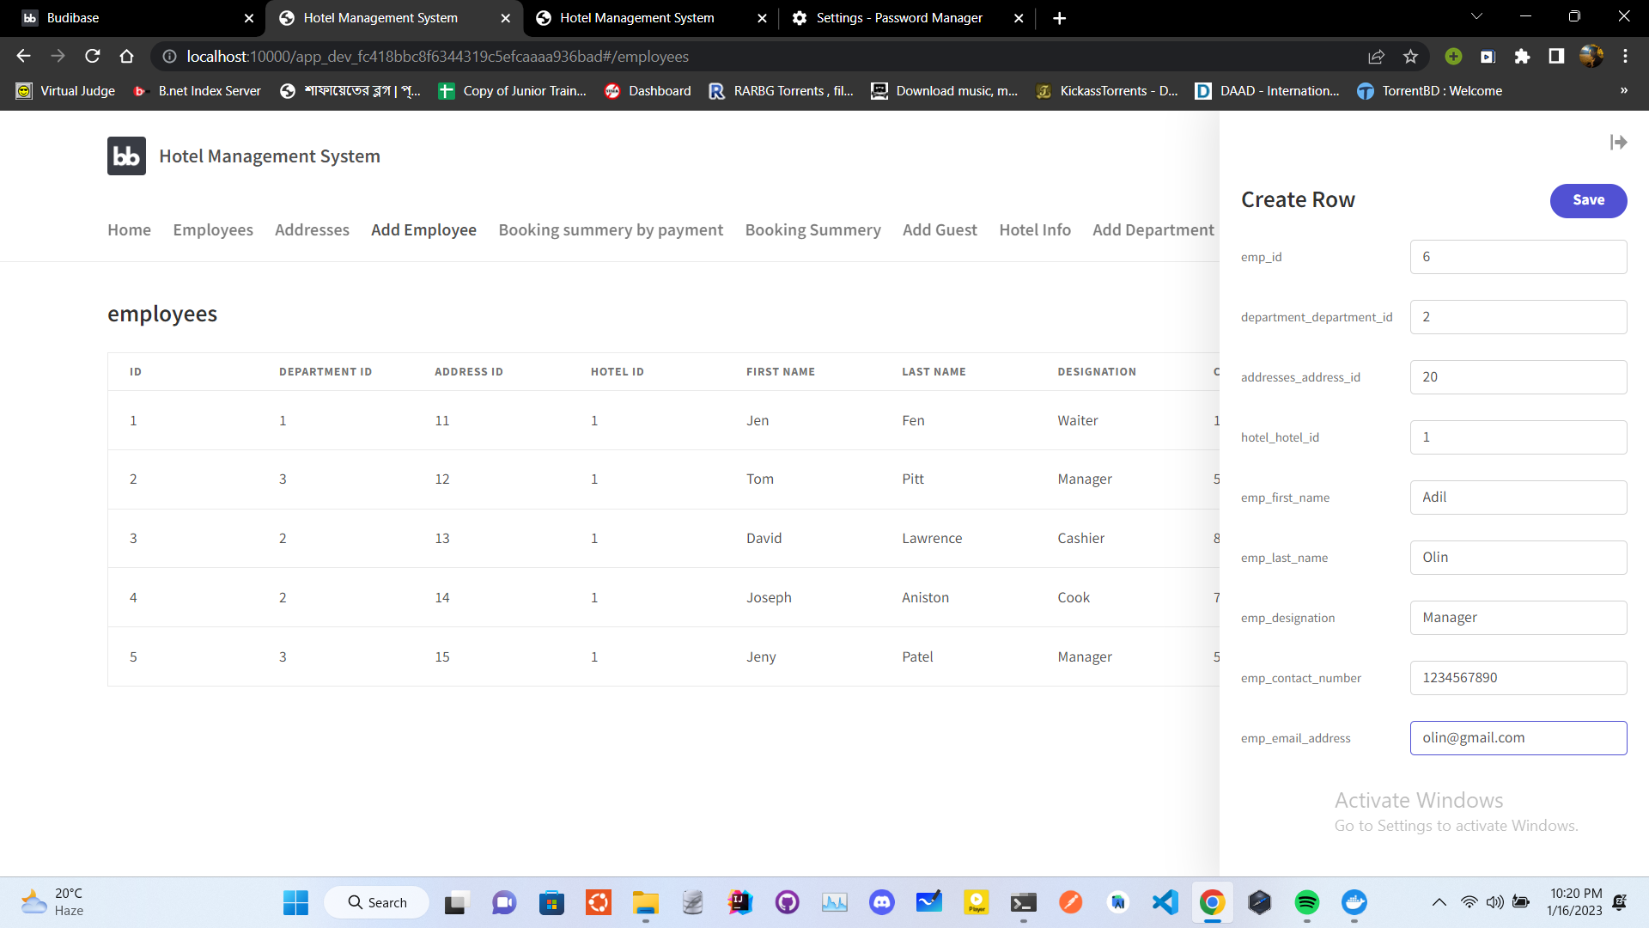
Add Employees Table

Slide 11
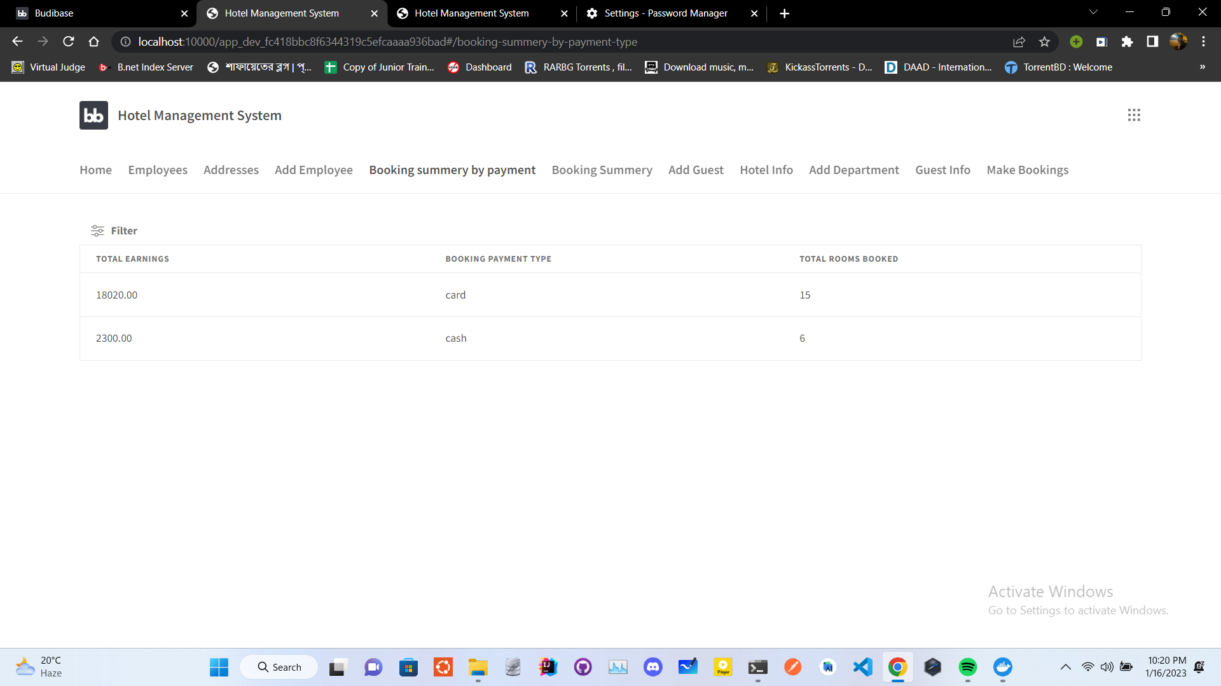
Booking SummaryBy Payment Table

Slide 12
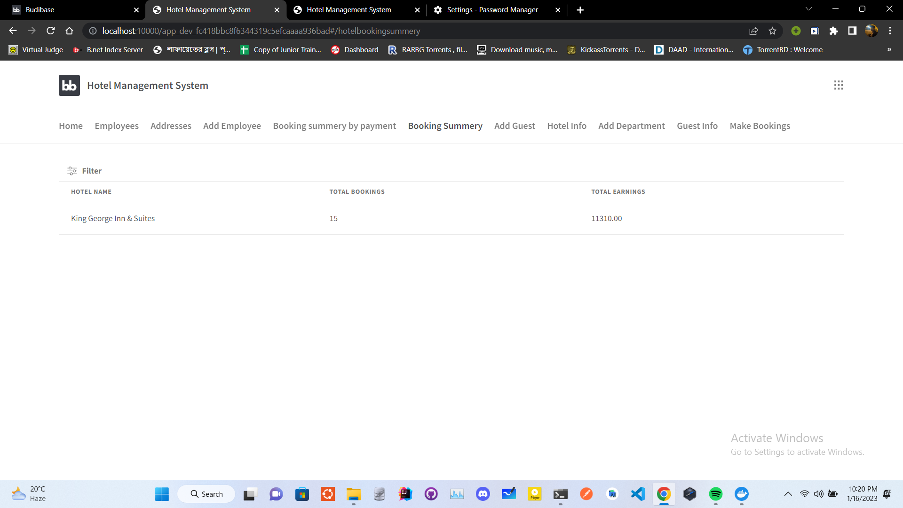
Booking Summary Table

Slide 13
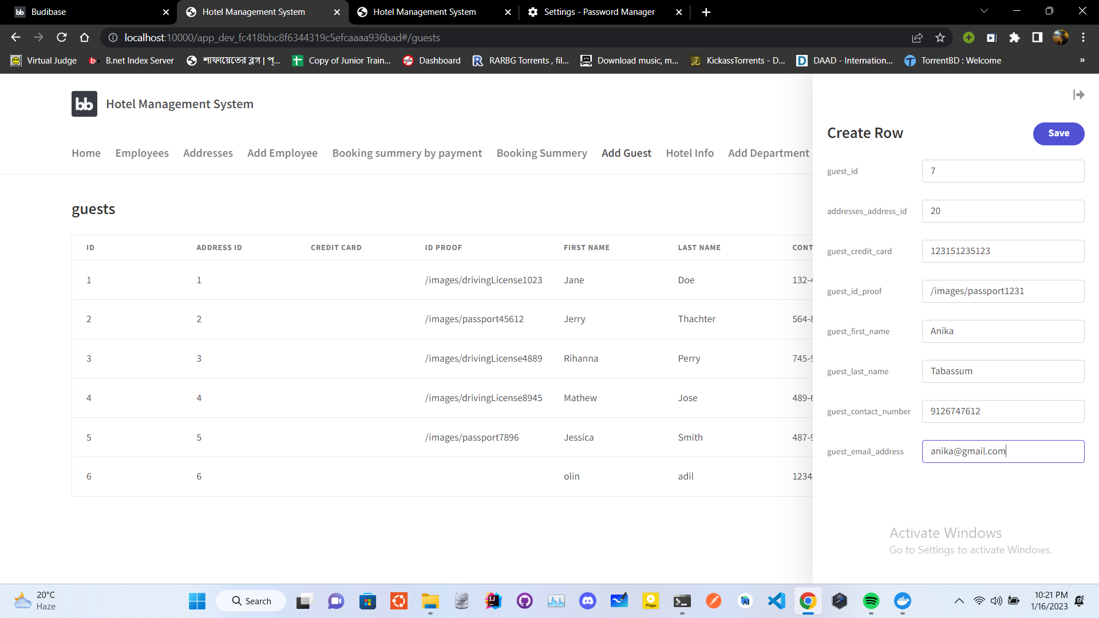
Guest Table

Slide 14
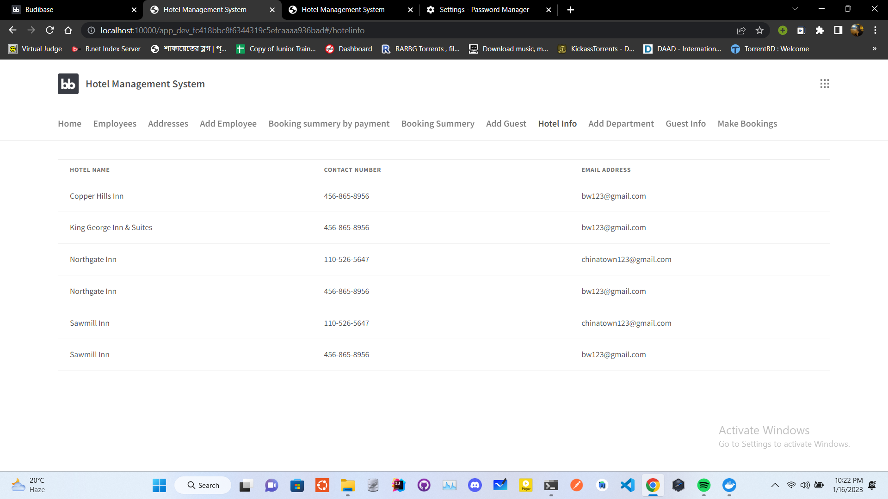
Hotel Information Table

Slide 15
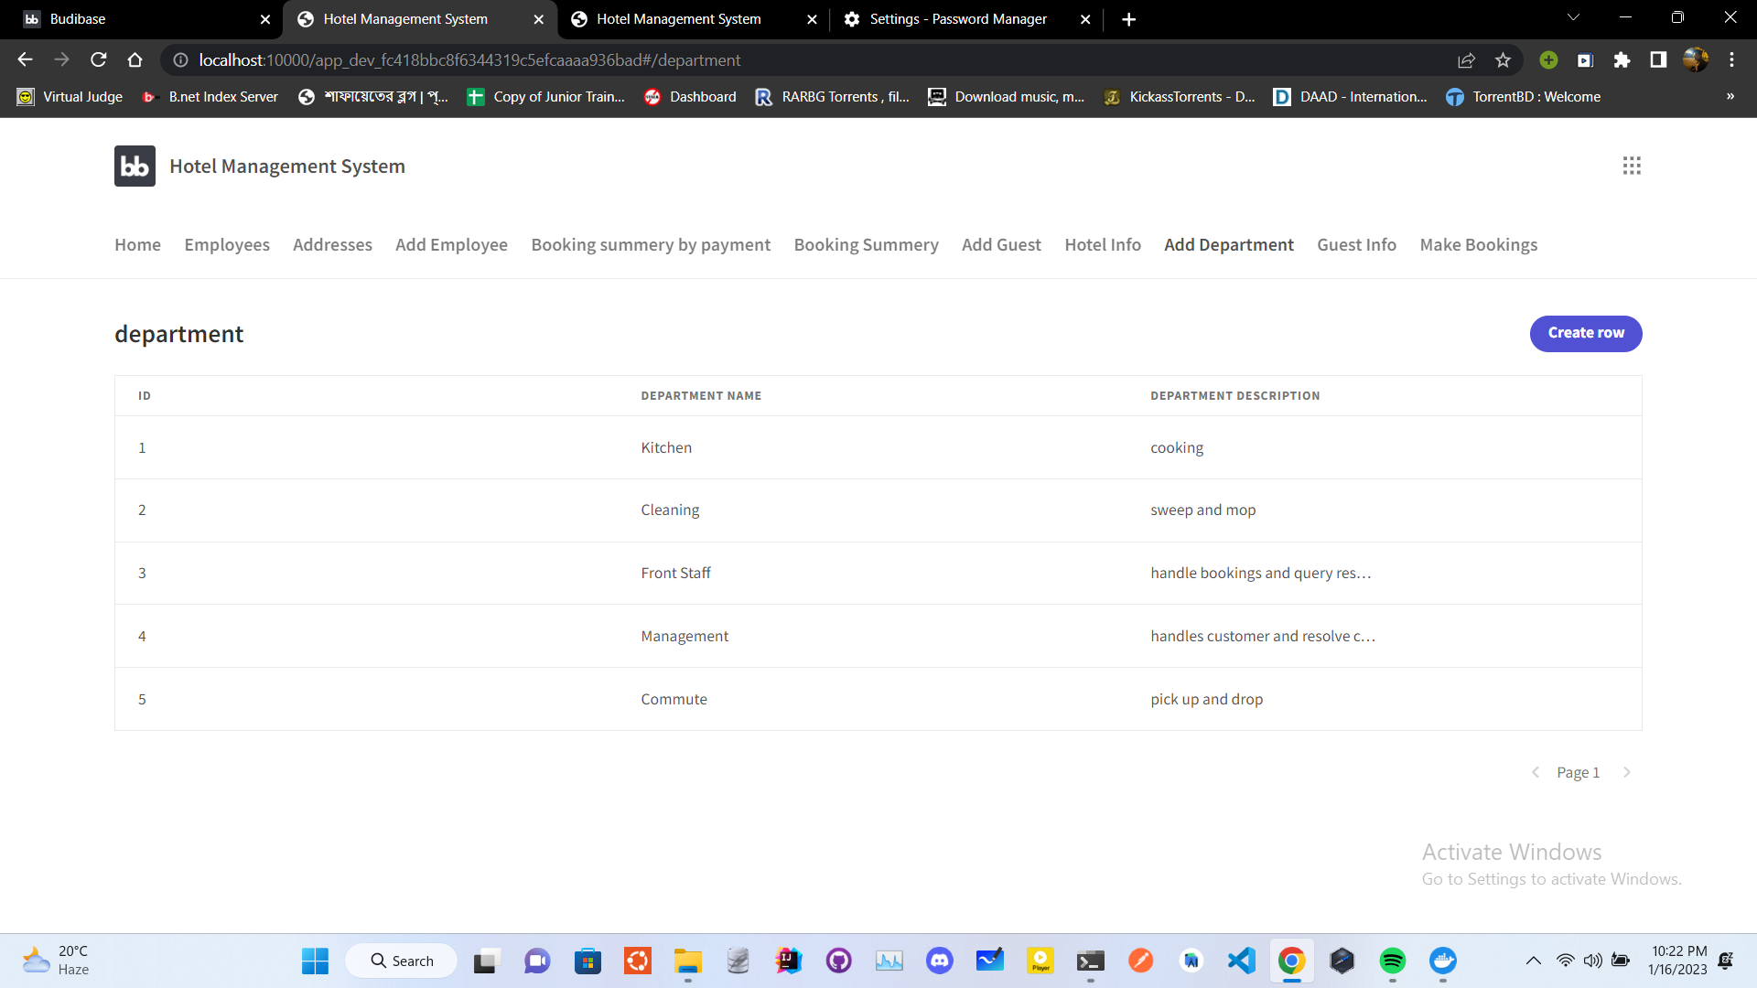
Department Table

Slide 16
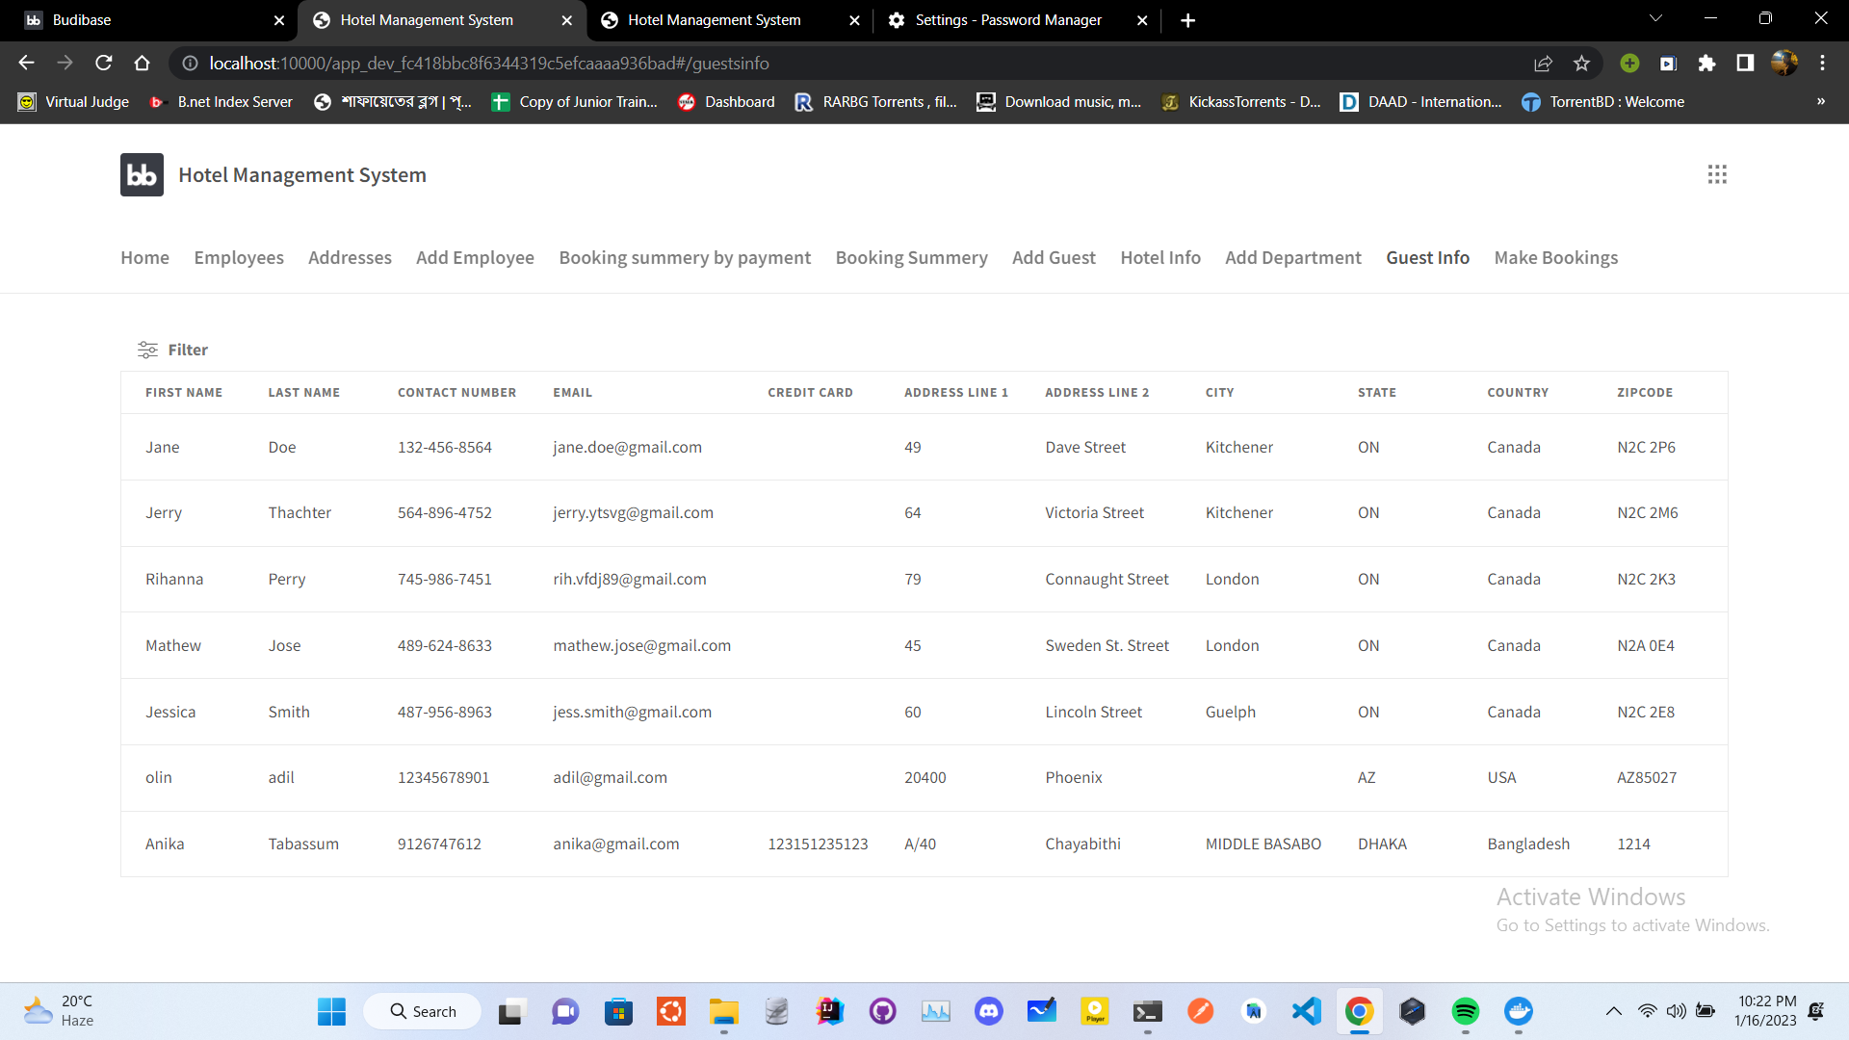
Guest Information Table

Slide 17
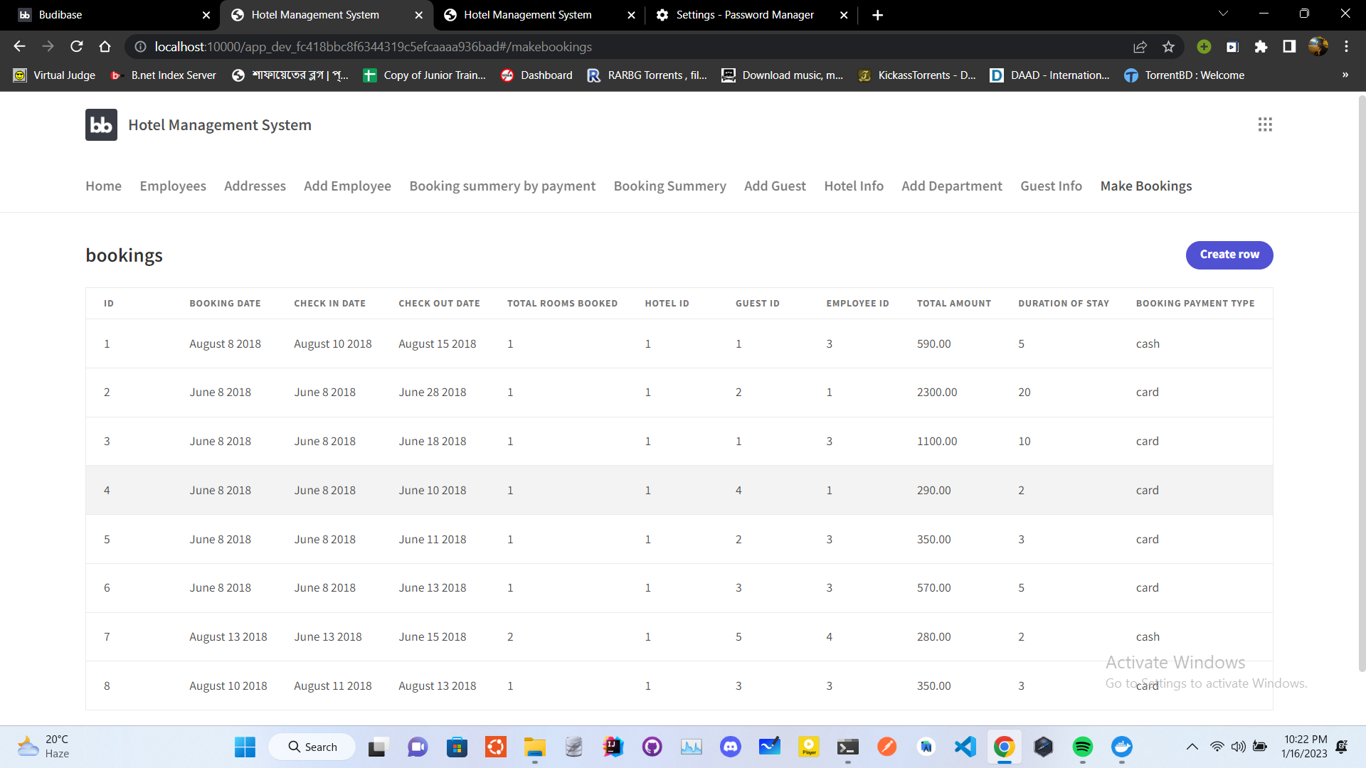
Make Bookings Table

Slide 18
Future Plan
The future of hotel database management systems is likely to focus on increasing automation and integration with other technologies, such as the Internet of Things (IoT) and artificial intelligence (AI). This could include things like:
Automated data entry and validation, reducing the chances of human errors.
Predictive analytics that can be used to identify trends and patterns in guest behavior, allowing hotels to better anticipate and meet guest needs.
Real-time data updates, which will enable hotels to make more accurate and efficient decisions.
Advanced security measures to protect sensitive guest data from breaches and cyber-attacks.
Flexible data management options that allows hotels to manage the data in the way that best suits their needs.
Automated inventory management, that allows the hotel to keep track of inventory levels, manage bookings, and optimize pricing strategies.

Slide 19

That’s it! Thank you very much for your time!
If you have any questions regarding the presentation, please feel free to ask us!
We will be more than happy to answer you ☺

